Slide 1
Lesson A Faces of the World
Listening
Conversation
Lesson B Are You Typical?
Listening 1
Listening 2
Oral Practice
Listening Skills

Slide 2

Listening
New words and expressions A. Listening for gist B. Listening for details
Argentina 阿根廷
Ashley 阿西里
Brazil 巴西
cool adj. If you say someone is cool, you mean that they are fashionable and attractive. 时髦的，引人注意的
Eva 伊娃
guy n. 男人
Hiroshi 藤原浩
identity n. Your identity is who you are. 身份
Iran 伊朗
Japan 日本
London 伦敦
Maheen 马亨
Malaysia 马来西亚
Michael 迈克
Sofia 索菲亚
yeah adv. 是，是的，好的
yep adv. 是（美国俚语）

Slide 3

Listening
New words and expressions A. Listening for gist B. Listening for details
Listen to the recording once and answer the following questions.
What are the man and the woman talking about? They are talking about the identity of each person in the photos.
What might be their relationship? They might be friends or classmates.
s .
They might be friends or classmates.

Slide 4
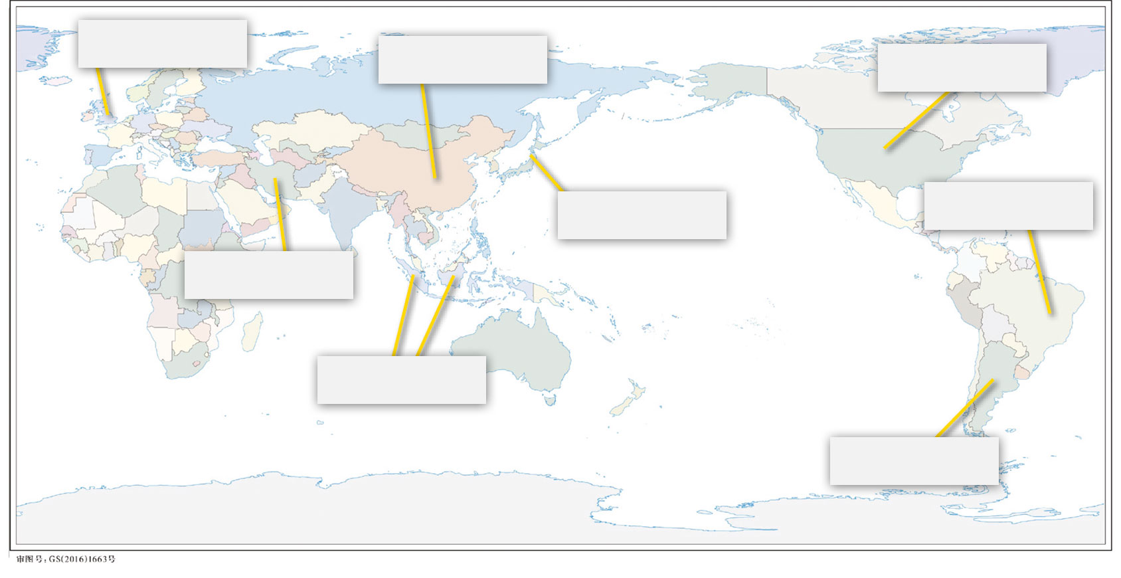
Listening
New words and expressions A. Listening for gist B. Listening for details
1. Locate the countries in the box (a to h) on the map.
a. Argentina b. Brazil c. China d. Iran e. Japan f. Malaysia g. the U.K. h. the U.S.
4 g. the U.K.
7 c. China
1 h. the U.S.
8 e. Japan
3 b. Brazil
5 d. Iran
6 f. Malaysia
2 a. Argentina

Slide 5
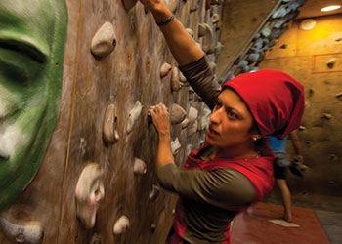

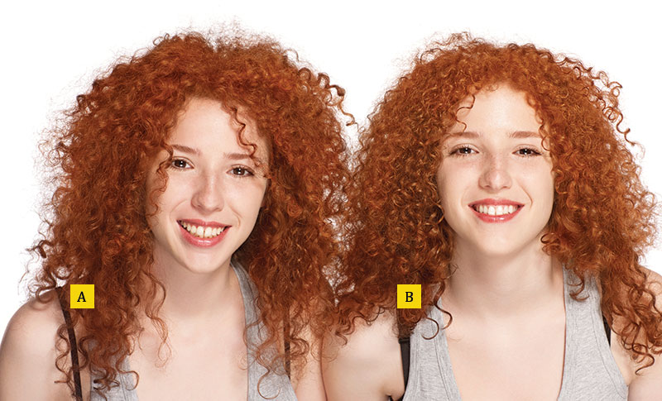


Listening
New words and expressions A. Listening for gist B. Listening for details
2. Listen to the recording again. Where is each person from? Write the country and the person’s name on each photo.
2. Country: Iran
First name: Maheen
3. Country: the U.K.
First name: Michael
.
1. Country: the U.S. First name (A): Eva First name (B): Ashley
4. Country: Brazil
First name: Sofia
5. Country: Japan
First name: Hiroshi
.

Slide 6

Conversation
Listen to the conversation and practice with a partner by using your own name and country. Then change partners and practice again.
A: Hi, my name is Michael.
B: Hi, Michael. I’m Sofia.
A: Great to meet you, Sofia.
B: It’s nice to meet you, too. Where are you from?
A: I’m from the U.K. And you?
B: Brazil. / Me too.t
A: Hi, my name is Michael.
B: Hi, Michael. I’m Sofia.
A: Great to meet you, Sofia.
B: It’s nice to meet you, too. Where are you from?
A: I’m from the U.K. And you?
B: Brazil. / Me too.

Slide 7
Listening 1
A. New words and expressions B. Pre-Listening questions C. Listening exercises D. Think about it
Study the words in the box and choose the right word for each blank.
billion | cell phone | centimeter | different | foot
inch | male | Mandarin | similar | typical
Mandarin is the official language of Chinese.
A(n) centimeter is a unit of length equal to one-hundredth of a meter.
A(n) inch is 2.54 centimeters.
One foot is 12 inches (about 30 centimeters).
A(n) billion is a thousand million.

Slide 8
Listening 1
A. New words and expressions B. Pre-Listening questions C. Listening exercises D. Think about it
Study the words in the box and choose the right word for each blank.
billion | cell phone | centimeter | different | foot
inch | male | Mandarin | similar | typical
A phone that you can carry with you everywhere is a(n) cell phone.
If someone is a(n) typical person of a group, he or she is similar to many members in that group.
If something is similar to another, they are nearly the same.
Mandarin and English are different languages.
A boy is male while a girl is female.

Slide 9
Listening 1
A. New words and expressions B. Pre-Listening questions C. Listening exercises D. Think about it
Discuss the following questions with a partner.
Where are you from? What is the typical person in your hometown like?

Slide 10
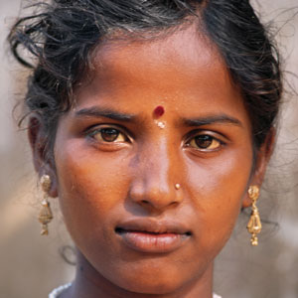

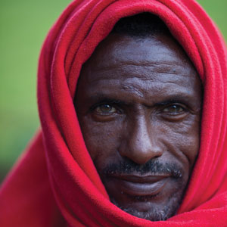
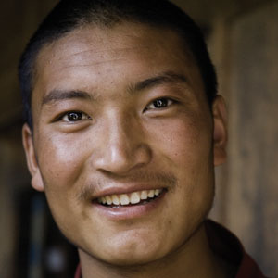
Listening 1
A. New words and expressions B. Pre-Listening questions C. Listening exercises D. Think about it
Exercise 1: Listening for gist. Listen to the recording once and answer the following questions.
What is the man talking about? He is talking about the typical person on Earth.
Who is the world’s most typical person? Circle the photo (a to d).
a
b
c
d

Slide 11
Listening 1
A. New words and expressions B. Pre-Listening questions C. Listening exercises D. Think about it
Exercise 2. Listening for details. 1. Listen to the passage again and answer the questions. Write the correct numbers.
How many people are there on Earth? Over 7,000,000,000.
How many countries are there on Earth? 195.
How many languages are there in the world? Over 7,000.
How many typical people are there on Earth? Over 9,000,000.
How many Chinese speakers are there on Earth? More than 900,000,000.

Slide 12
Listening 1
A. New words and expressions B. Pre-Listening questions C. Listening exercises D. Think about it
Exercise 2. Listening for details. 2. Fill in the blanks with the information you get from the recording about the typical person.
The typical person on Earth is male. He is 28 years old and is 174 centimeters (about 5 feet 8 inches) tall.
The most typical person lives in a city and has a cell phone.
He also speaks Mandarin Chinese.

Slide 13
Listening 1
A. New words and expressions B. Pre-Listening questions C. Listening exercises D. Think about it
Work with a partner. Are you similar to or different from the person in the photo circled? Explain with sentences 1 to 6 below.
I’m a (man / woman).
I’m ________ years old.
I’m ________ centimeters tall.
I (live / don’t live) in a city.
I (speak / don’t speak ) Chinese.
I (have / don’t have ) a cell phone.
I’m different. I’m a woman. Also, I’m nineteen.

Slide 14
Listening 2
New words and expressions A. Listening for gist B. Listening for details
census n. A census is an official count of the population of a country. 人口普查
Kim 金姆
Korea 韩国
Lisa 丽莎
married adj. If you are married, you have a husband or wife. 已婚的
single adj. Someone who is single is not married. 单身的

Slide 15
Listening 2
New words and expressions A. Listening for gist B. Listening for details
Listen to the recording and give answers to the following questions.
What is the man doing? He is asking a woman some questions.
Who is the woman? She is a student from Korea.
.
.

Slide 16
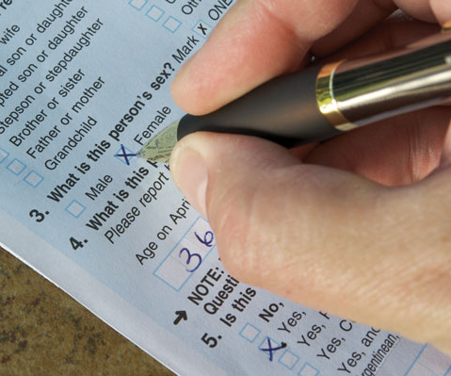

Listening 2
New words and expressions A. Listening for gist B. Listening for details
1. Listen to the recording again and number the questions 1 to 5 in the order the man asks them.
Content Note
A census is a survey given to a population to collect basic information usually about common topics such as housing, family members, employment, schooling, etc.
The information collected can be used in a number of ways, from research to business marketing. There is debate about whether a census survey is really accurate in finding out what is typical among a population.
Many governments take census surveys every ten years.
Census Form
1 What’s your name?
5 How old are you?
4 Are you married or single?
2 Where are you from?
3 What do you do?
A census counts the number of people in a country. It also asks questions about age, job, and other information.

Slide 17
Listening 2
New words and expressions A. Listening for gist B. Listening for details
2. Give detailed information about the woman.
Name: Lisa Kim
Sex: female
Age: 23
Marital status: single
Job: student
Nationality: Korea
single
student
Korea

Slide 18
Oral Practice
A. Important language B. Discussion
My Your His Her | name is Alex. name is Sofia. name is Mr. Razak. name is Ms. Tanka. | I You He She | am are is is | a student. | I am = I’m You are = You’re He is = He’s She is = She’s
Our Your Their | names are Alena and Liya. | We You They | are | students. | We are = We’re You are = You’re They are = They’re

Slide 19
Oral Practice
A. Important language B. Discussion
Numbers
0 | zero | 10 | ten | 20 | twenty | 30 | thirty
1 | one | 11 | eleven | 21 | twenty-one | 40 | forty
2 | two | 12 | twelve | 22 | twenty-two | 50 | fifty
3 | three | 13 | thirteen | 23 | twenty-three | 60 | sixty
4 | four | 14 | fourteen | 24 | twenty-four | 70 | seventy
5 | five | 15 | fifteen | 25 | twenty-five | 80 | eighty
6 | six | 16 | sixteen | 26 | twenty-six | 90 | ninety
7 | seven | 17 | seventeen | 27 | twenty-seven | 100 | one hundred
8 | eight | 18 | eighteen | 28 | twenty-eight | 1,000 | one thousand
9 | nine | 19 | nineteen | 29 | twenty-nine | 1,000,000 | one million

Slide 20
Oral Practice
A. Important language B. Discussion
Census questions
What’s your name?
How do you spell that?
Where are you from?
How old are you?
Are you married or single?
What do you do?
How many people are there in your family?

Slide 21
Oral Practice
A. Important language B. Discussion
Asking for personal information.
Some ideas of census questions include:
How many people are living in your household?
What language is spoken in your household?
What is your ethnic origin?
What schools have you attended?
Do you currently have health insurance?
Have you ever been in the military?
Language Note
Work with a partner. Ask and answer the census questions on the previous page. Think of two extra questions and ask your partner.
How many people are there in your family?
There are five: my mother, my father, my two brothers, and me.

Slide 22
Listening for Specific Information: Numbers
It is necessary for us to listen for specific words that contain the information we need. This exercise focuses on one kind of required information — numbers.
You can identify a zip code by listening out for a number that comes either right before or right after the name of a city or country. The numbers are usually read individually. For example, the American zip code 33671 would be read as three-three-six-seven-one.
When discussing money, numbers will usually be read in blocks of three digits. If cents are involved, the word “and” is added before their value. For example:
$168.91 will be read as one hundred sixty-eight dollars, and ninety-one cents.
$1,168,910 will be read as one million one hundred sixty-eight thousand nine hundred ten dollars.

Slide 23
Listen to the recording and fill in the blanks with numbers you hear.
Remember to put down the zip code when you address the envelope. Mine is 92381.
Sally’s aunt has just come back from France. Now she’s staying at the Pearl Hotel, Room 2608.
Mr. Davis lives at 1540 Water Street.
It usually takes about 75 minutes to get to the airport from here.
The new coat cost me 156 yuan.
The Tower of London is more than 900 years old.
Mr. Baker has been working in the City Bank of New York for two years. He now has an annual income of $84,200.
New York is 1735 miles away from here.

